Slide 1


DEPARTMENT OF COMPUTER SCIENCE
CROP PREDICTION USING MACHINE LEARNING
Dr.T. Kumaragurubaran., M.Tech., Ph. D AP(SG).,
PROJECT COORDINATOR
Professor
ADEN JOE A
210701013
DEEPANCHAKKARAVARTHI P
210701047

Slide 2
Abstract
Crop prediction is vital for agriculture, helping farmers choose the best crops for optimal yields. Machine learning (ML) is now a powerful tool for accurate crop predictions. This study focuses on using ML to predict crop yields in India, aiming to assist farmers in making informed decisions and boosting productivity. Agriculture in India is crucial, employing many and contributing significantly to the economy, yet yield prediction is challenging due to diverse climates, soils, and practices. Traditional methods often lack accuracy, leading to poor decisions.. ML addresses this by analyzing large data sets to find patterns and make predictions. We used ML algorithms like Linear Regression, Decision Trees, Random Forest, and Support Vector Machines (SVM) on historical data including weather, soil, crop types, and farming methods. Data from government databases, weather stations, and local records were preprocessed for analysis. Further research is needed to refine these models and make them widely accessible to farmers.

Slide 3
Existing System
In the existing system of crop prediction using machine learning, traditional methods often struggle to accurately forecast crop yields due to the complex and dynamic nature of agricultural ecosystems. These traditional approaches rely on statistical models or empirical techniques, which may not adequately capture the diverse factors influencing crop growth and productivity. To address these challenges, researchers and practitioners have increasingly turned to machine learning techniques for crop prediction.As a result, farmers often face challenges in making informed decisions about crop selection, resource allocation, and management practices, leading to suboptimal outcomes and reduced agricultural productivity. As such, while machine learning holds promise for revolutionizing crop prediction in Indian agriculture, further research and development are needed to address these challenges and realize its full potential in improving agricultural productivity and food security.

Slide 4
Proposed System
In the proposed system of the crop prediction project using machine learning, we aim to revolutionize the way farmers make decisions about their crops. By harnessing the power of advanced technology, specifically machine learning algorithms, we seek to develop a system that can accurately forecast crop yields. Our approach involves collecting and analysing diverse agricultural data, including information on weather patterns, soil conditions, crop varieties, and historical yield records. By leveraging this data, our machine learning models will identify patterns and relationships that influence crop growth and productivity.By leveraging cutting-edge technology, we aim to enhance agricultural productivity, improve food security, and uplift the livelihoods of farmers. Through continued research and development, we are committed to realizing the full potential of machine learning in revolutionizing crop prediction and fostering sustainable agricultural development in India

Slide 5
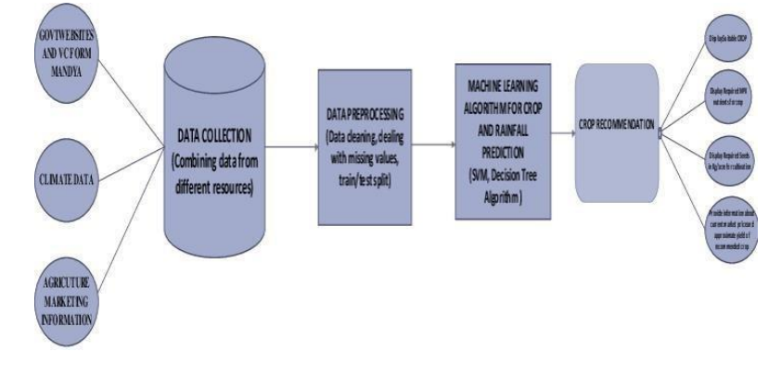
System Architecture

Slide 6
List of Modules
Data Collection Module
Data Preprocessing Module
Model Training Module
Prediction Module

Slide 7
Functional Description for each modules
Data Collection Module:
The Data Collection Module is crucial for gathering soil-related data inputs directly from farmers. This module provides an interface—either through a web or mobile application—where farmers can input various soil parameters. Key soil attributes typically include nitrogen (N), phosphorus (P), potassium (K) levels, temperature, humidity, pH level, and rainfall. These inputs are critical for making accurate crop recommendations. The module ensures data is collected in a structured format suitable for further processing. User-friendly input methods, validation checks, and error handling are incorporated to enhance data accuracy and user experience.

Slide 8
Functional Description of Module
Data Preprocessing Module:
The Data Preprocessing Module prepares the raw soil data for analysis, ensuring it is clean and consistent. This step involves handling missing values, normalizing or standardizing data, and converting inputs into formats compatible with machine learning algorithms. Feature engineering might be performed to create new relevant features or transform existing ones. This module guarantees that the data fed into the machine learning models is of high quality, which is essential for reliable predictions. Proper preprocessing reduces the risk of errors during the model training phase and enhances the model’s performance.

Slide 9
Functional Description of Module
Model Training Module:
The Model Training Module is responsible for building and training machine learning models using historical soil and crop data. This module involves splitting the dataset into training and testing sets, selecting appropriate algorithms (e.g., Logistic Regression, Decision Tree, Naive Bayes, Random Forest), and training these models on the training set. It evaluates the models using performance metrics like accuracy, precision, and recall to select the best-performing model. This module also includes saving the trained model to disk using serialization techniques (e.g., joblib) for future use. Effective model training is pivotal for making accurate crop predictions.

Slide 10
Functional Description of Module
Prediction Module:
The Prediction Module utilizes the trained machine learning model to make crop recommendations based on new soil data inputs from farmers. It first preprocesses the input data to ensure it matches the format and scale used during model training. The preprocessed data is then fed into the trained model to predict the most suitable crop for the given soil conditions. This module provides the prediction results back to the user, which can be displayed on the interface. This module’s efficiency and accuracy are crucial, as they directly impact the utility and reliability of the crop recommendation system for farmers.

Slide 11
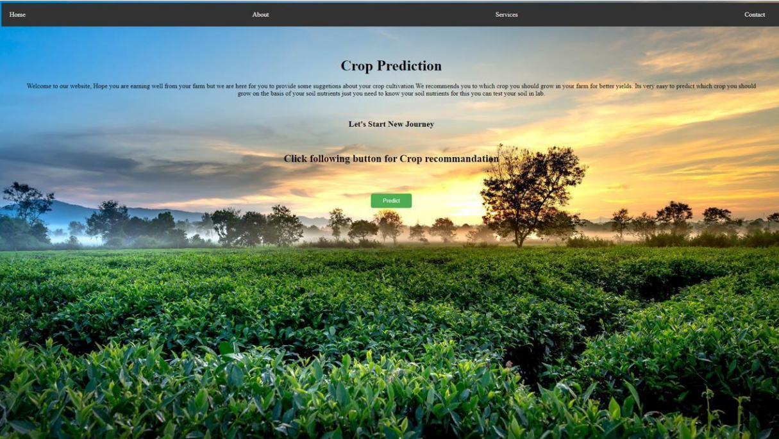
FINAL OUTPUT
LANDING PAGE:

Slide 12
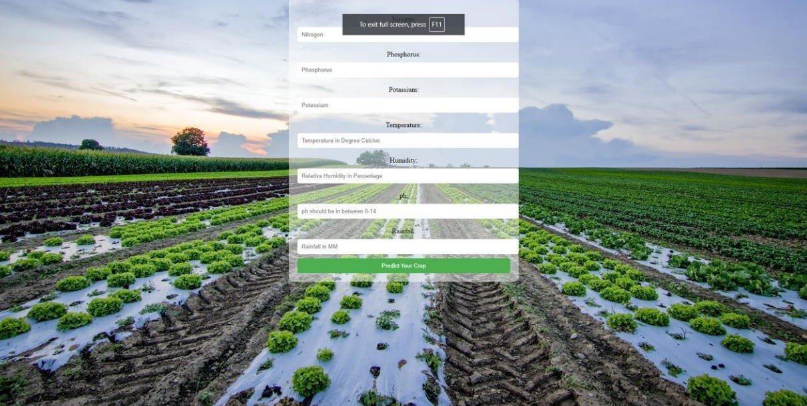
FINAL OUTPUT

Slide 13
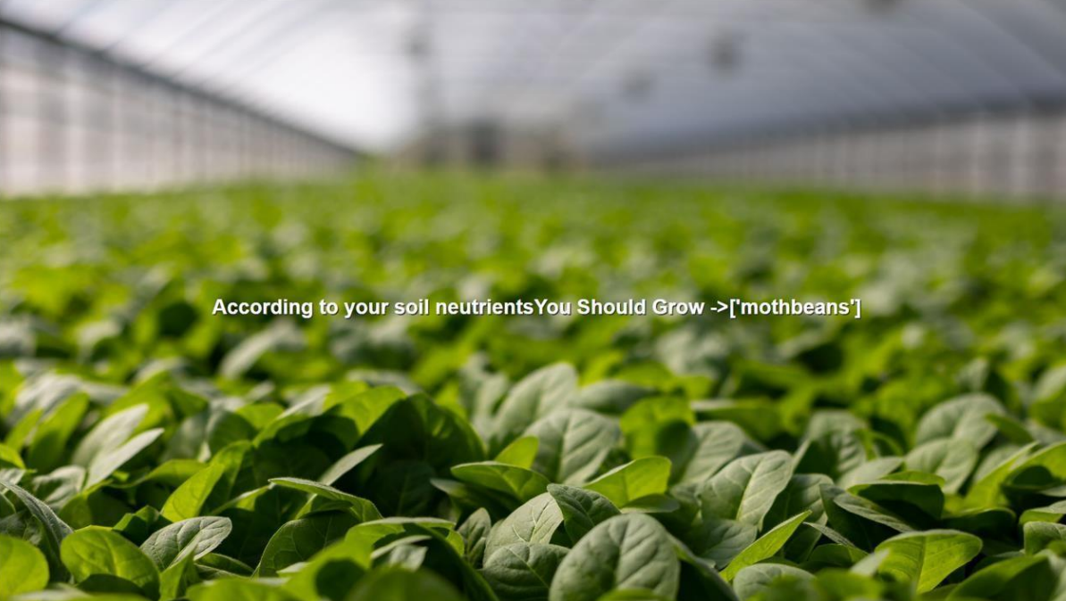
FINAL OUTPUT

Slide 14
Conclusion
In conclusion, the project "Crop Prediction Using Machine Learning" marks a significant step forward in revolutionizing agricultural practices in India. By harnessing the power of machine learning algorithms and extensive agricultural data, the project has demonstrated the potential to provide farmers with valuable insights and predictions for optimizing crop yields. Through the development of accurate predictive models, farmers can now make informed decisions about crop selection, planting schedules, and resource allocation, leading to improved agricultural productivity and economic stability. The user- friendly interface ensures accessibility for farmers of all backgrounds, empowering them to leverage technology for better outcomes in their farming endeavors. Moving forward, continued research and innovation in crop prediction using machine learning hold immense promise for further advancing agricultural practices and supporting the needs of farmers nationwide. By embracing technology and data- driven approaches, India's agricultural sector can thrive, ensuring a brighter and more sustainable future for generations to come.

Slide 15
References
Flask Framework for Python Developer (Book)
Data Analytics Using Python (Book)
Data Visualization Using Python (Book)
https://www.ncbi.nlm.nih.gov/
https://www.safetyandquality.gov.au/
https://www.covetus.com/blog/
https://www.nhsinform.scot/campaigns/health-and-social-care-standards/
https://analytics.google.com/analytics/academy/

Slide 16
Thank You

